Slide 1
Games Bootcamp
Advanced UI & UX

Slide 2
Recap
Persistent Data.

Slide 3
Table of contents
01
Localisation
04
UI Interactivity
02
UI Animation
05
Testing & Debug
03
UI Responsiveness

Slide 4
01
Localisation

Slide 5
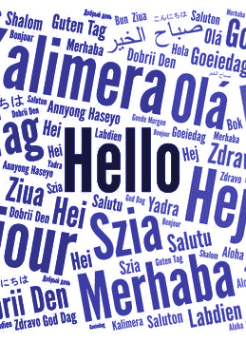
Localisation (1)
The process of adapting the game to a specific region or locale.
Prices should reflect in the local currency
UI text translated or altered to the region
Regional regulations or preferences

Slide 6
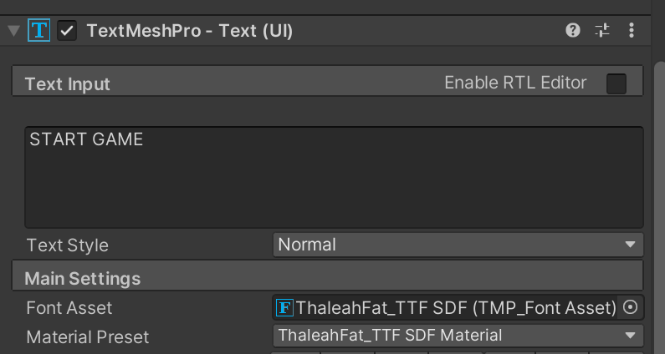
Localisation (2)
‘Hard-coding’ text in game makes this process difficult.
It means we have to manually change every text component manually.
We need to update the text at runtime.
Notes:
There is a unity package but we will be making a basic solution to understand how the process would work.

Slide 7
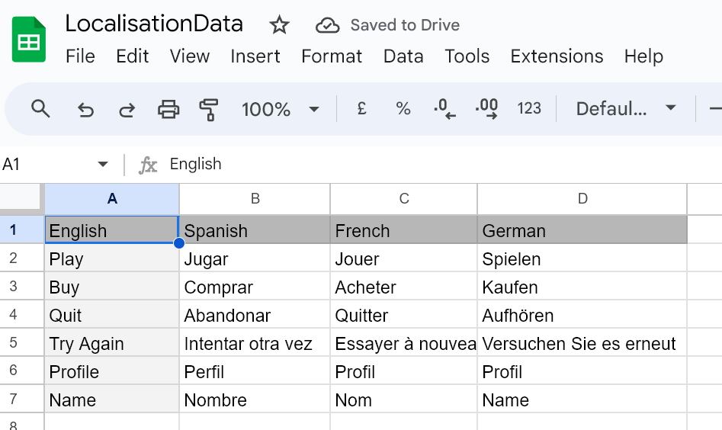
Localisation (3)
Localisation requires a table or library of assets.
This can be used for any type of asset
we can use the translate function in excel to translate text in the game to different languages
This is not a perfect solution
Notes:
There is a unity package but we will be making a basic solution to understand how the process would work.

Slide 8
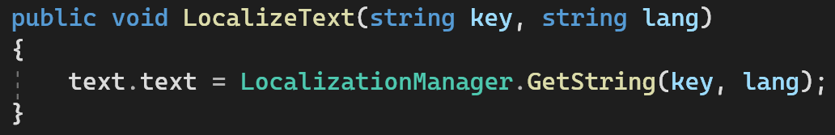
Localisation (3)
These tables can be converted to a dictionary
At runtime we can use the current language and string key to set the text
Notes:
There is a unity package but we will be making a basic solution to understand how the process would work.

Slide 9
02
UI Animation

Slide 10
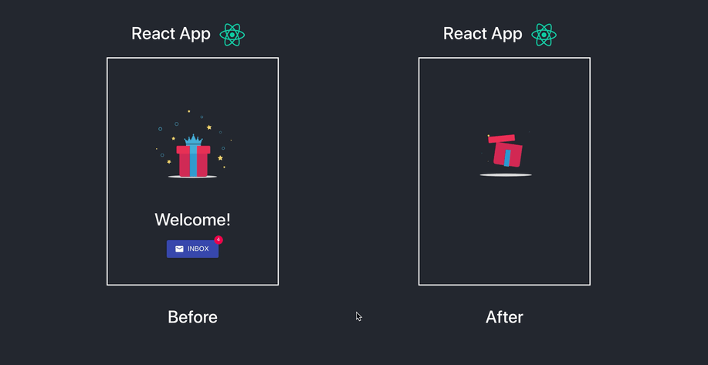
UI Animation (1)
The use of motion, transitions or effects to make the interface visually engaging
Makes the game feel responsive
Feedback to the player
Can hide background loading
Makes transitions less jaring
Notes:
There is a unity package but we will be making a basic solution to understand how the process would work.

Slide 11
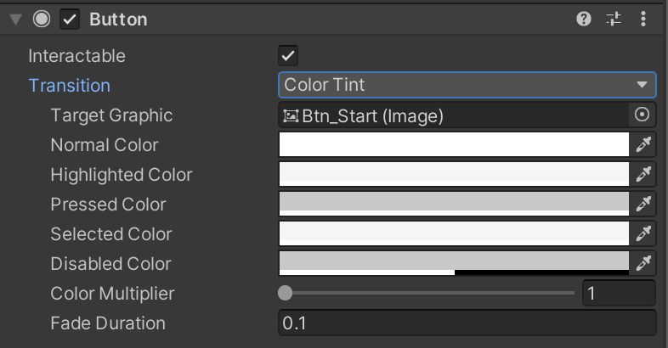
UI Animation (2)
You can animate UI using Tweening or the Animator system
Tweening allows for basic implementations like fades,slides and delays to be implemented through code
Buttons have a pre-built transition system that you can use with colors, sprites or animations.
The button will change the button based on the current state
Notes:
There is a unity package but we will be making a basic solution to understand how the process would work.

Slide 12
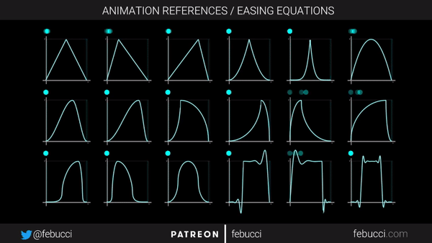
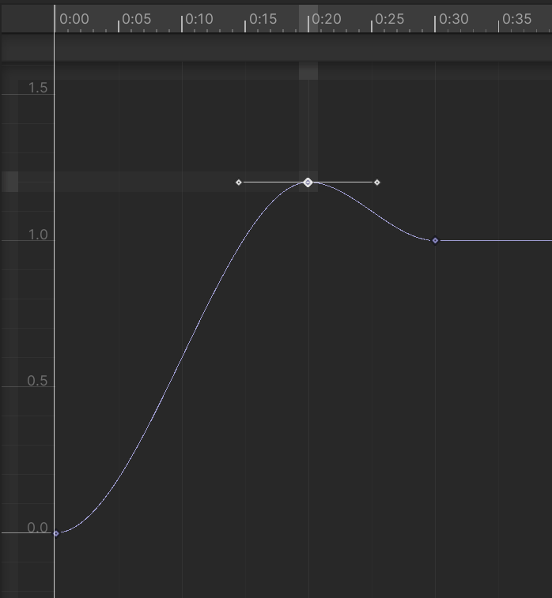
UI Animation (3)
You can use animation curves to create more appealing looking fades and transitions
Notes:
There is a unity package but we will be making a basic solution to understand how the process would work.

Slide 13
03
UI Responsiveness
You can enter a subtitle here if you need it

Slide 14
UI Responsiveness (1)
Object Pooling
UI Batching
An unresponsive or slow UI can ruin the experience. Having a lot of elements or objects can create performance issues. There are some methods to mitigate this.
Technique used to efficiently manage and reuse objects in Unity. Instead of instantiating and destroying objects frequently, you create a pool of objects at the start and reuse them when needed.
When UI elements share the same material and sorting layer, Unity batches them together during rendering, reducing the number of draw calls and improving performance.

Slide 15
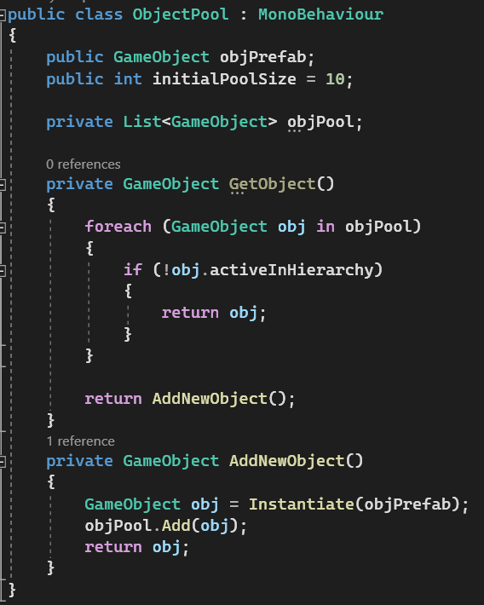
UI Responsiveness (2)
Steps to for Object Pooling:
Create a list of objects and spawn an initial amount
retrieve an available object from the pool
Once used you can return it back to the pool
If there are no available objects you can instantiate more and add them to the pool
Notes:
There is a unity package but we will be making a basic solution to understand how the process would work.

Slide 16
04
UI Interactivity

Slide 17
UI Interactivity (1)
Unity provides interfaces for more advanced interactions like drag&drop. An interface is a contract telling a class it must implement some defined functions.
These are named ‘I’ followed by a description name.
IBeginDragHandler, calls OnBeginDrag.
IDragHandler calls OnDrag continuously while the user is dragging their finger
IEndDragHandler calls OnEndDrag.
Notes:
There is a unity package but we will be making a basic solution to understand how the process would work.

Slide 18
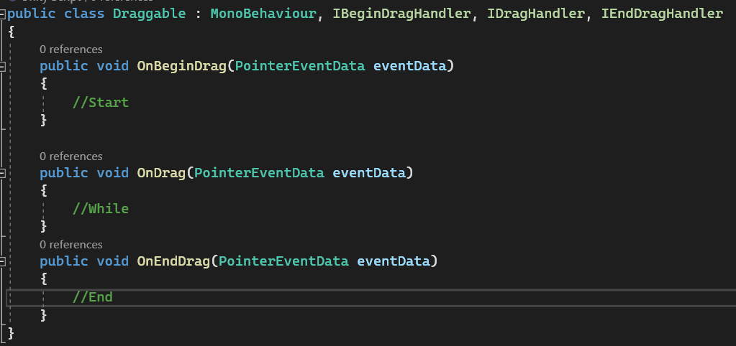
UI Interactivity (2)
Notes:
There is a unity package but we will be making a basic solution to understand how the process would work.

Slide 19
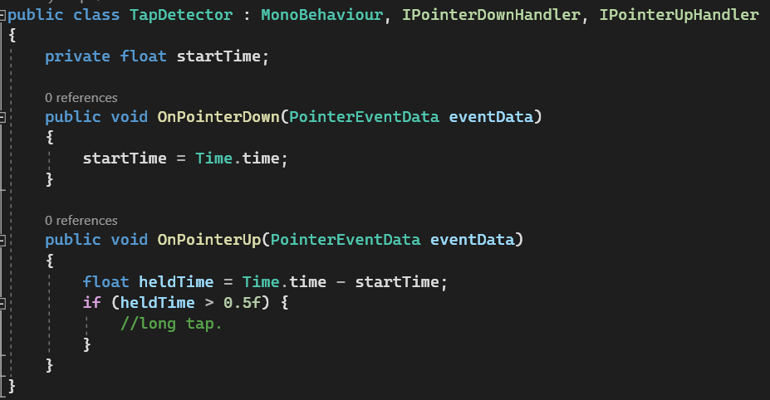
UI Interactivity (3)
The OnPointer interfaces allows for more complex touches: Long-tap, double-tap, or detecting taps on non-ui elements.
We have two interfaces IPointerDown & IPointerUp
Time.time is the total time in seconds since the start of the application
In this example we are checking the time difference and deciding whether it was a long tap if it was held for longer than 0.5 seconds.
Notes:
There is a unity package but we will be making a basic solution to understand how the process would work.

Slide 20
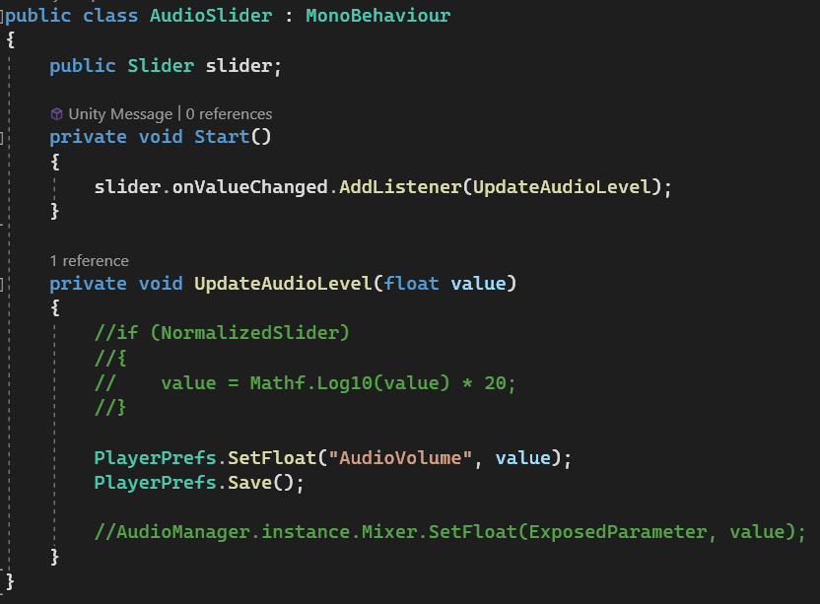
UI Interactivity (3)
Unity’s UI elements have events that we can listen to.
For example sliders have an OnValueChanged event
To subscribe to an event you need a function with the same signature.
In this case UpdateAudioLevel has a float parameter.
We can then use this to set the volume in our audio mixer
We can also use playerprefs to load values.
Notes:
COVER TESTING AND DEBUGGING

Slide 21
05
Testing & Debugging

Slide 22
Thanks!

